Slide 1



NTPC: Overview and Key Insights
NTPC (National Thermal Power Corporation) is India's largest energy conglomerate and one of the largest power generation companies in the world. With a diverse energy portfolio and a strong focus on sustainability, NTPC plays a crucial role in powering India's economic growth.
by Shreyansh Jain.

Slide 2

About NTPC
Established
Presence
Ownership
NTPC was established in 1975 as a central public sector undertaking to accelerate power development in India.
NTPC operates across India with a presence in over 25 states, generating power from a mix of fuel sources.
NTPC is majority-owned by the Government of India, with a public shareholding of around 15%.

Slide 3

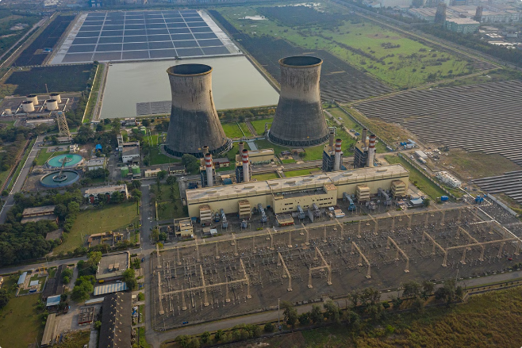
NTPC's Power Generation Capacity
1
2021: 66 GW
NTPC's total installed capacity reached 66 GW, making it one of the largest power generation companies in the world.
2
2025 Target: 130 GW
NTPC aims to increase its generation capacity to 130 GW by 2025, with a focus on renewable energy sources.
3
2032 Target: 250 GW
NTPC's long-term goal is to achieve a total installed capacity of 250 GW by 2032, further strengthening its position in the Indian power sector.

Slide 4
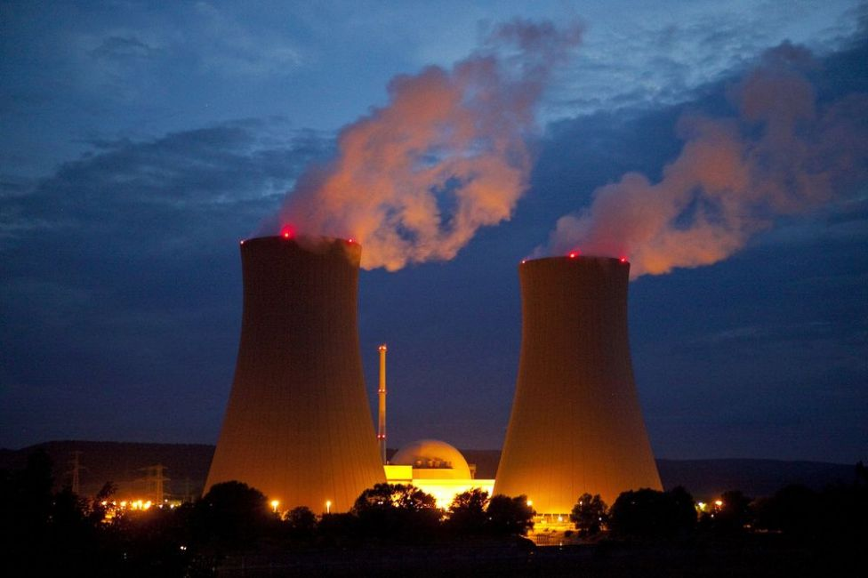
Fuel Mix and Diversification
Thermal Power
Renewable Energy
Nuclear Power
NTPC's primary source of power generation is thermal energy, primarily from coal-based power plants.
NTPC is actively diversifying its energy mix, with a growing focus on renewable sources like solar, wind, and hydropower.
NTPC also operates a nuclear power plant, contributing to its diversified energy portfolio.

Slide 5

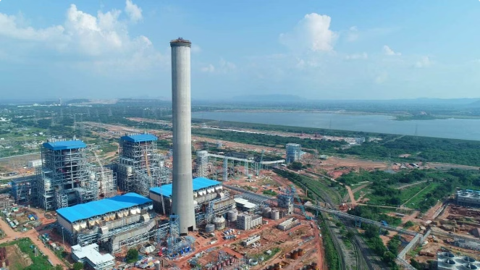
Renewable Energy Initiatives
1
Solar Power
NTPC has set ambitious targets to increase its solar power generation capacity, aiming to become a leader in renewable energy.
2
Wind Power
NTPC is also expanding its wind power portfolio, leveraging India's vast wind energy potential.
3
Hydropower
NTPC's hydropower projects contribute to its diversified renewable energy mix, providing clean and reliable power.
4
Green Hydrogen
NTPC is exploring the development of green hydrogen production facilities to further enhance its sustainability efforts.

Slide 6

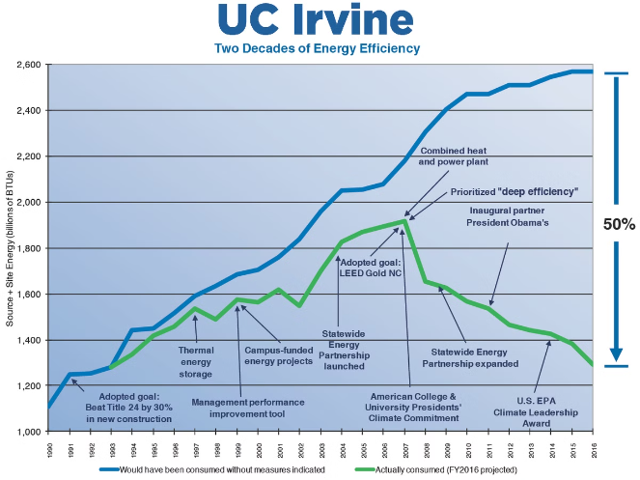
Operational Efficiency and Cost Management
Plant Availability
NTPC consistently maintains high plant availability, ensuring reliable power supply to its customers.
Emission Reduction
NTPC has made significant strides in reducing its carbon footprint through various efficiency improvements and emission control measures.
Cost Optimization
NTPC's focus on operational excellence and cost management has enabled it to maintain competitive electricity tariffs.
Digitalization
NTPC is leveraging digital technologies to enhance its operational efficiency and optimize its resource utilization.

Slide 7






Financial Performance and Growth
Revenue Growth
NTPC has consistently reported robust revenue growth, reflecting its strong market position and operational efficiency.
Profitability
NTPC maintains a healthy profit margin, driven by its focus on cost optimization and diversified energy mix.
Dividend Payouts
NTPC has a track record of providing consistent dividend payouts to its shareholders, making it an attractive investment option.

Slide 8

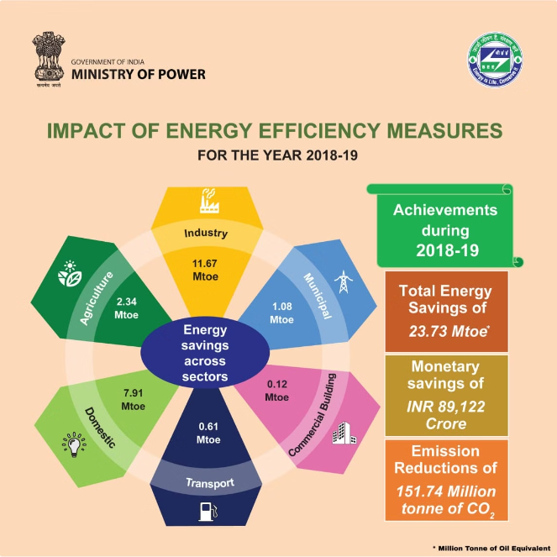



Regulatory Environment and Policy Landscape
Regulatory Framework
NTPC operates within a well-defined regulatory framework, with policies and guidelines set by the central and state governments.
Policy Alignment
NTPC aligns its strategies with the government's energy policies, focusing on renewable energy targets and sustainability goals.
Incentives and Support
The government provides various incentives and support measures to promote the growth of the power sector, which benefits NTPC.

Slide 9


Challenges and Risks
1
Coal Dependency
NTPC's heavy reliance on coal-based power generation exposes it to fuel supply risks and environmental concerns.
2
Regulatory Uncertainty
Changes in government policies and regulations can impact NTPC's operations and financial performance.
3
Climate Change Impacts
NTPC's assets and operations are susceptible to the effects of climate change, necessitating adaptation strategies.
4
Competition from Renewables
The growing competitiveness of renewable energy sources poses a challenge to NTPC's traditional coal-based power business.

Slide 10

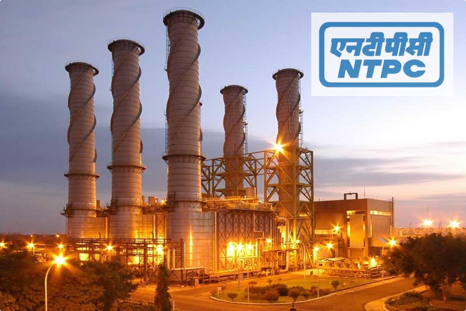
Future Outlook and Strategic Priorities
Renewable Energy Expansion
NTPC aims to significantly increase its renewable energy capacity to support India's sustainability goals.
Diversification and Innovation
NTPC is exploring new business opportunities in areas like green hydrogen, energy storage, and carbon capture technologies.
Operational Excellence
NTPC will continue to focus on improving efficiency, reducing emissions, and optimizing costs to maintain its competitive edge.
Financial Stability
NTPC's strong financial performance and growth will enable it to fund its ambitious expansion plans and create value for shareholders.

